Slide 1
SDLC:How to get from design to production!
Notes:
Few notes:
Make use of the emoji feature to interact, type any questions in the chat.

Slide 2

Hello world!
I AM MEMONA HAQ
I am here because I enjoy sharing knowledge and connecting with people.
You can find me at:
linkedin.com/in/memona-haq-4191b778

Slide 3
What is SDLC?
Software Development Life Cycle.
A systematic process for building software that ensures the quality and correctness of the software built.
Notes:
SDLC stands Software development life cycle
It is a systematic process for building software
It aims to ensures the quality and correctness of the software built
It can be quite challenging to translate an idea into an actual working application
SDLC process is there to help you produce high-quality software that meets customer expectations.
It helps decide how to plan, build, and maintain software.
also referred to as the Application Development life-cycle

Slide 4
Why SDLC?
Helps decide where to start
Creates standards
Increases Visibility
Quicker results
Improves relationships
Decreases risk
Notes:
It offers a basis for project planning, scheduling, and estimating
Provides a framework for a standard set of activities and deliverables
It helps you track and control the project
Increases visibility of project planning to all involved stakeholders of the development process
Increased development speed
Improved client relations because of the visibility
Helps you to decrease project risk

Slide 5
SDLC Phases
Divided into 7 stages

Slide 6
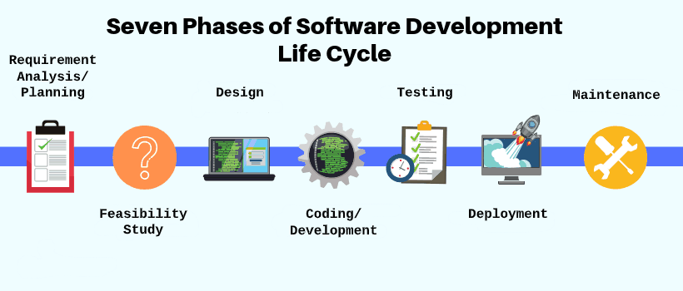
SDLC Phases
Notes:
Not always the same stages and order

Slide 7


Phase 1: Requirement collection and analysis
Collect information from customer
Quality assurance and risk assessment
Holistic view of the project
Detailed and precise requirements
Discuss timelines
Business Analyst
Project Manager
Notes:
The first stage in the SDLC process is Requirement collection and analysis
Usually performed by business analyst and project managers
In this phase all the relevant information is collected from the customer to develop a product that will meet their expectation
The business analyst and project manager will meet up with the customer to gather information regarding
what the customer wants to build, who will be the end-user, what is the purpose of the product.
They need to build a core understanding of the product
Input in taken in from all the stakeholders and domain experts in the industry
They plan for the quality assurance requirements and recognize the risks involved
This stage gives a clearer picture of the scope of the entire project including anticipated issues
this stage requires us to get detailed and precise requirements. Which helps companies to finalize the necessary timelines and cost.
This phase is very important. The business analyst needs to make sure what they understand is what is the customer wants. Otherwise

Slide 8
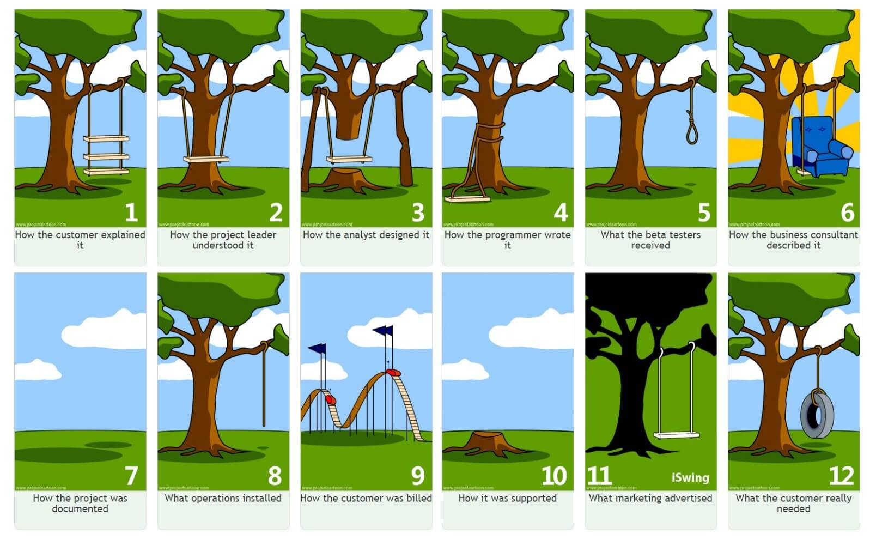

Slide 9
Phase 1: Pet Adoption Website
Customer needs a site that will help them with showing off pets that are available for adoption.
List of pets with pictures
Details about each pet:
Name
Age
Picture
Personality

Slide 10
Phase 2: Feasibility study
Define and document software needs
Software Requirement Specification Document (SRS)
Feasibilities checks:
Economic
Legal
Operations
Technical
Schedule
Business Analyst
Notes:
Once the requirement gathering is completed, the business analyst will do an analysis to check the feasibility of the development of a product.
If there is any ambiguity, it can be sorted out with the customer right away.
Once the requirement is clearly understood, the SRS (Software Requirement Specification) document is created
This includes everything which should be designed and developed during the project life cycle.
There are mainly five types of feasibilities checks:
Economic: Can we complete the project within the budget or not?
Legal: Can this project be handled within the law and other regulations
Operation feasibility: Can we provide the service according to requirements and operate and maintain after release
Technical: Do we have the right hardware, software and skills to build and support this project
Schedule: Decide that the project can be completed within the given schedule or not.

Slide 11
Phase 2: Pet Adoption Website
Do we have a domain name?
Do we have qualified front end and back end engineers?
Do we need authentication?
Can we finish this system in 2 months?
Can we keep within the budget?

Slide 12
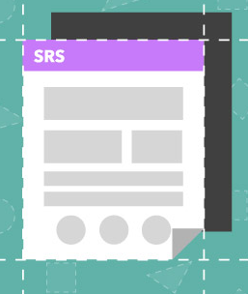

Phase 3: Design
How the system will be designed and built
List of technologies, frameworks, and libraries
Architecture
Workflow diagrams
Wireframes
Mockups
Designer
Notes:
In this phase, the designer uses the requirement gathered in the SRS document is used as an input
to create the software architecture that is used for system development
how the system will be designed and built, e.g. which tools and technologies are to be used.
List of technologies, frameworks, and libraries
Architecture - diagram used to abstract the overall outline of the system and the relationships, constraints, and boundaries between components
Workflow diagrams - visual representation of the processes
Wireframes - two-dimensional skeletal outline of a webpage or app
Mockups - a prototype that shows at least part of the functionality of a system and enables testing of a design

Slide 13
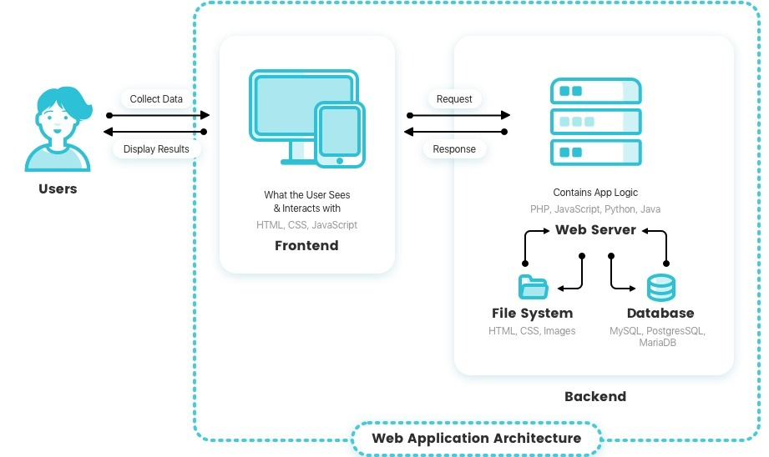
Architecture Diagram
Pet adoption backend logic
Pet adoption website
Pet adoption database

Slide 14
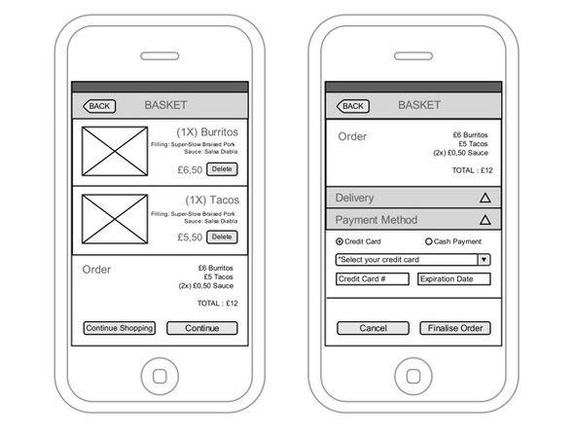
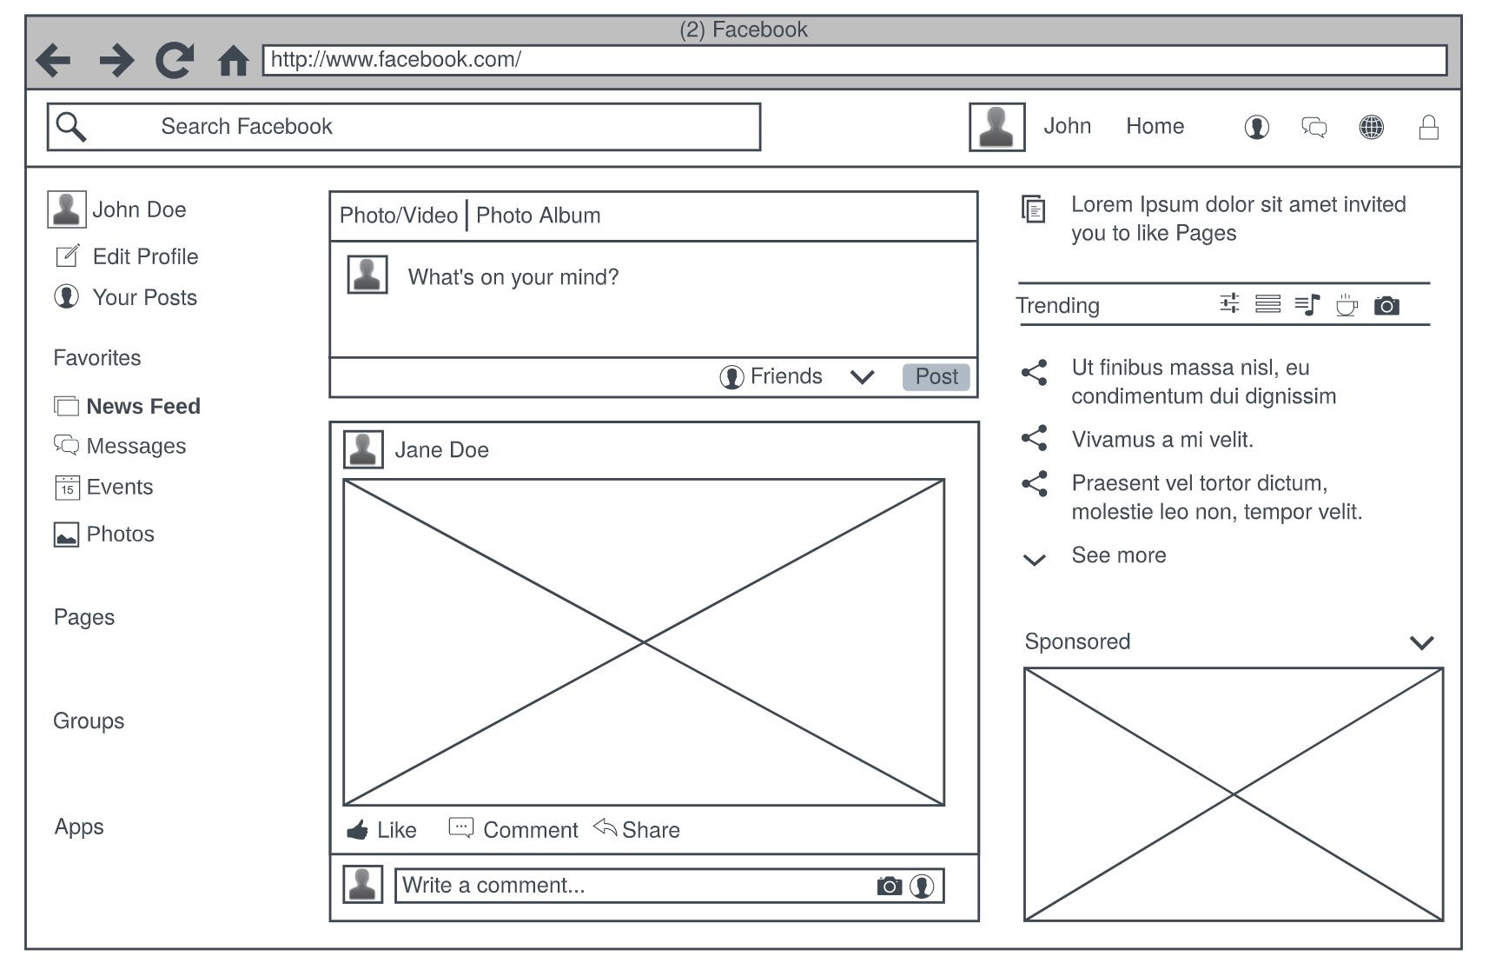
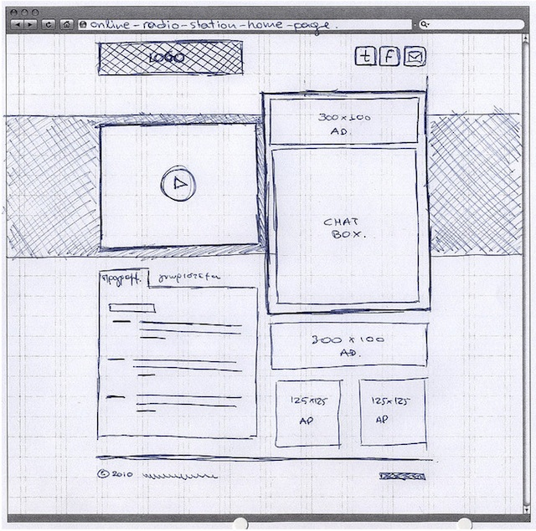
Wireframes

Slide 15
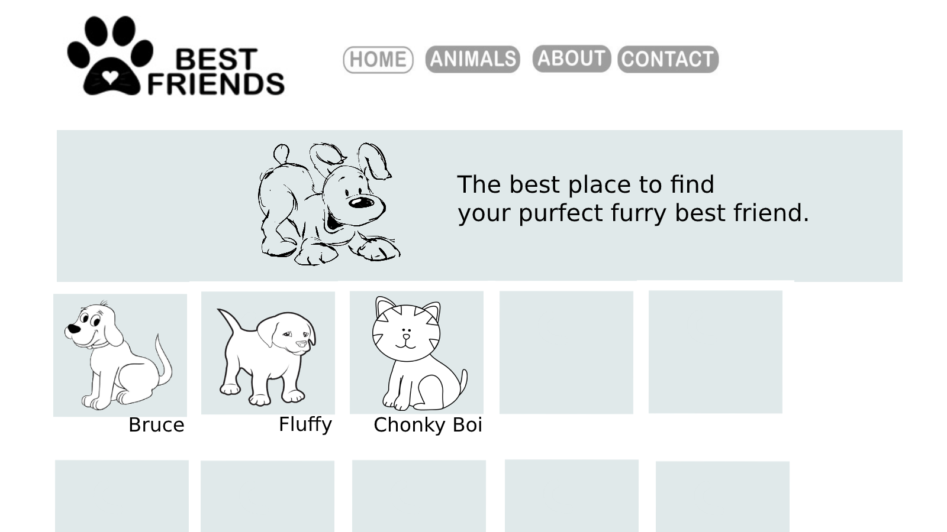
Phase 3: Pet Adoption Website

Slide 16
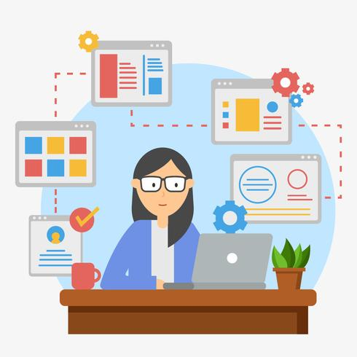
Phase 4: Development/Coding
Building the system by writing code
Tasks are divided
Longest phase
Coding guidelines
Developer
Notes:
Development starts once the developer gets the Design document.
And they start build the entire system by writing code using the chosen programming language.
In the coding phase, tasks are divided into units or modules and assigned to the various developers.
It is the longest phase of the Software Development Life Cycle process.
In this phase, Developer needs to follow certain predefined coding guidelines. They also need to use programming tools like compiler, interpreters, debugger to generate and implement the code.

Slide 17
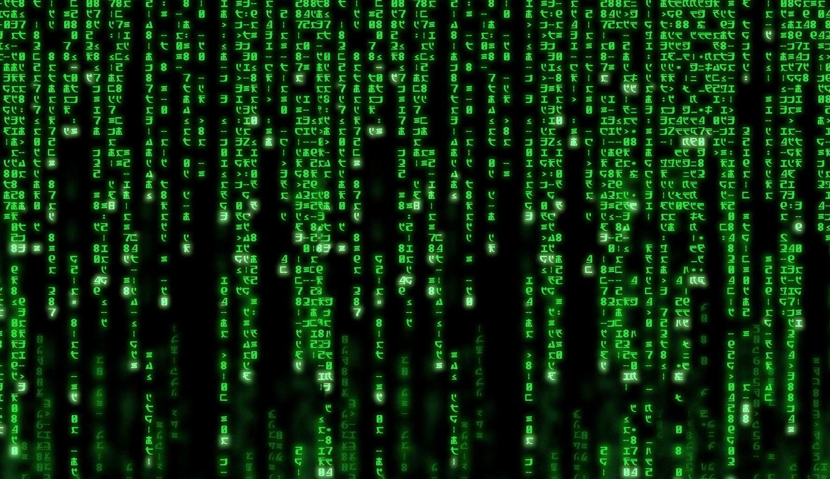
Notes:
Wait for it…

Slide 18
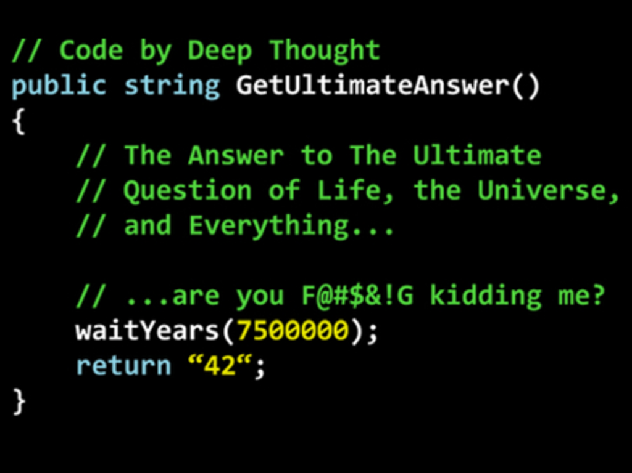
Code Example
Notes:
Here is an actual example of what code looks like and it can be 1000s of lines of this.

Slide 19
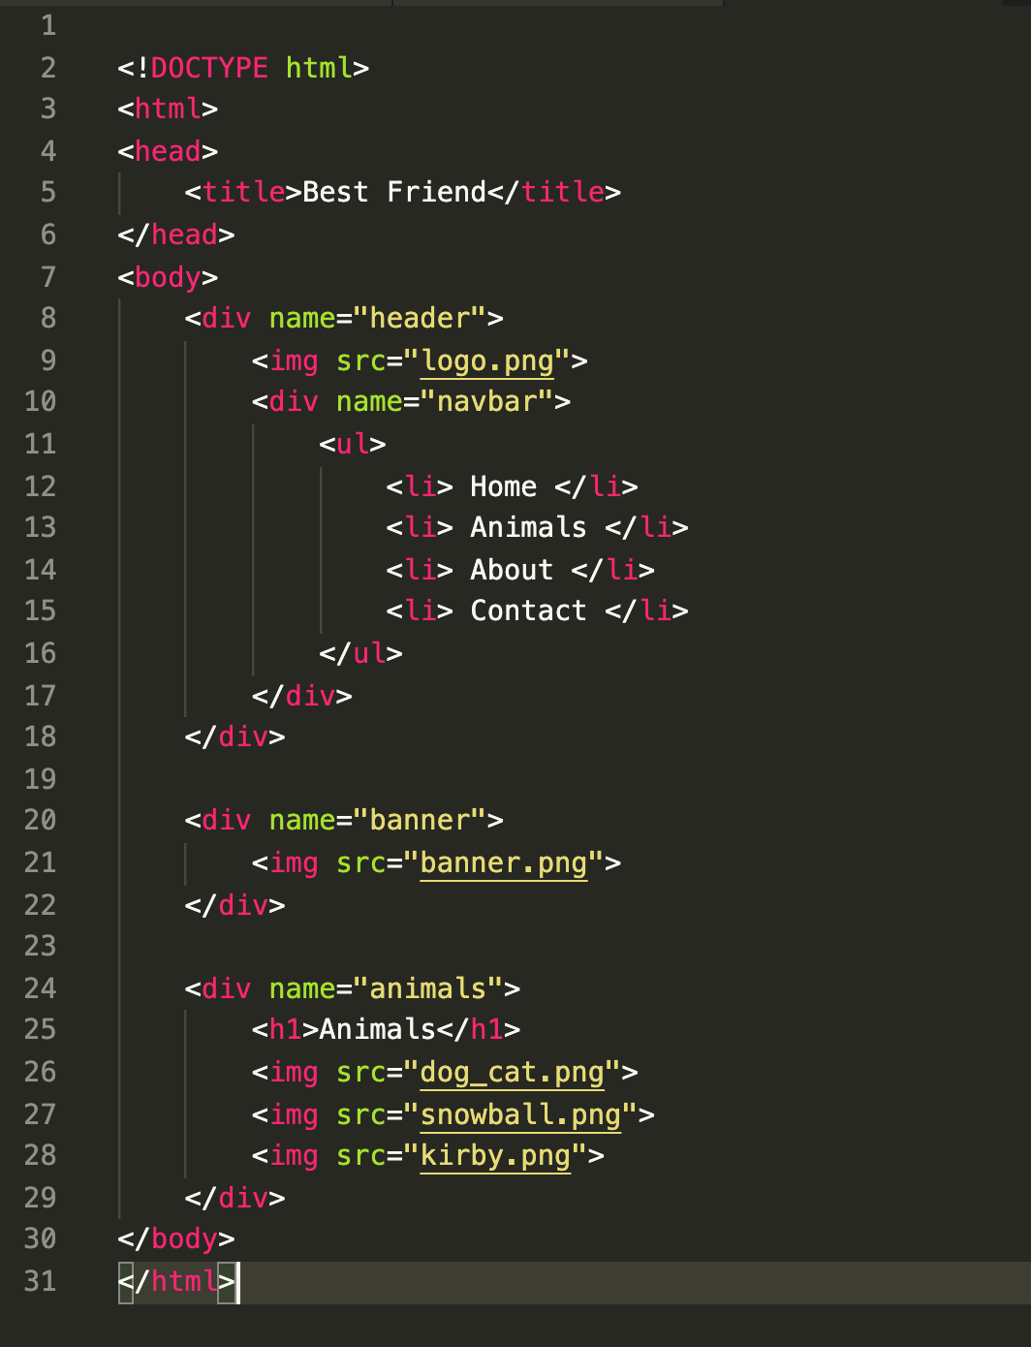
Phase 4: Pet Adoption Website

Slide 20
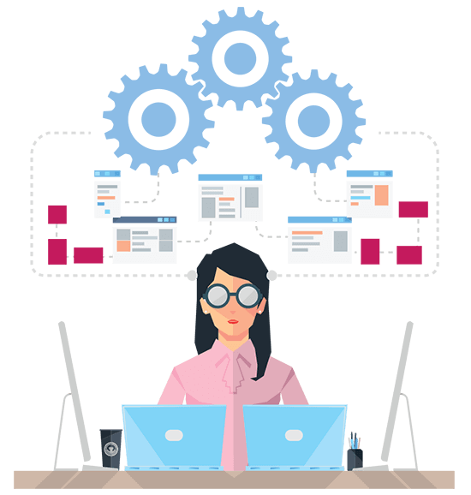
Phase 5: Testing
Testing functionality
Various methodologies for testing
Make sure everything works
Quality assurance
Report bugs
User Acceptance Testing (UAT)
Developer
Tester
Notes:
Testing starts once the coding is complete and the modules are released for testing.
There are different methodologies for testing (module per module, entire project or tests before dev)
In this phase, the developed software is tested thoroughly and any defects found are assigned to developers to get them fixed.
Retesting, regression testing is done until the point at which the software is as per the customer’s expectation.
Testers also refer SRS document to make sure that the software is as per the customer’s standard.
The code is deployed in a testing environment for User acceptance testing (UAT)
Which is basically a replica of the production environment and the customer along with the developers does the testing. If the customer finds the application as expected, then sign off is provided by the customer to go live.

Slide 21
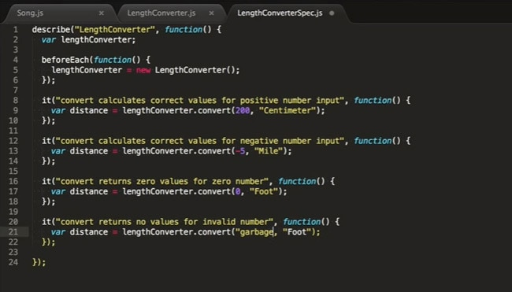
Testing Code Example
Notes:
Tests typically look like the dev code.
code is usually divided into units and these units of code are tested accordingly
one can view a unit as the smallest testable part of an application

Slide 22
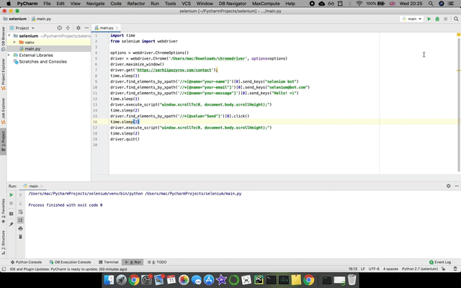
Automated Testing Example (Selenium)
Notes:
There’s another type of testing for front-end ui testing,
where the automated tests goes and clicks around on a page to make sure everything is where it should be and functions correctly.

Slide 23


Phase 6: Installation/Deployment
Go live
Packaged and released
Users can use it
Shipping the code to servers
Website, Desktop app or Mobile app
IT Operations / System admin
Notes:
Once the software testing phase is over and no bugs or errors left . Well there will almost always be errors.
Your software is ready to be released and is deployed in production.
This is where the it operations and system admins come in, they make sure the application is made available to users.
Shipping the code to a server or device
This can be the website online. App available for download.
Website – go to a link/url, Desktop app link on a website or Mobile app on the app store

Slide 24
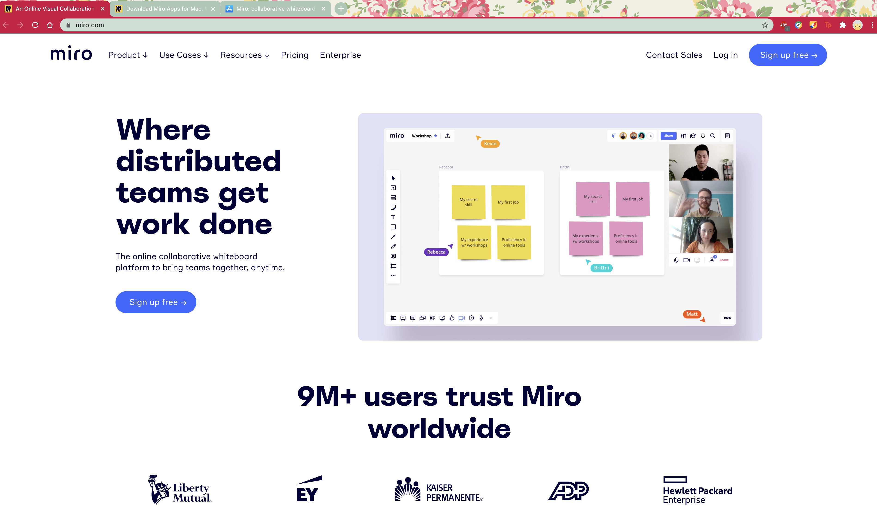
Deployed Website Example

Slide 25
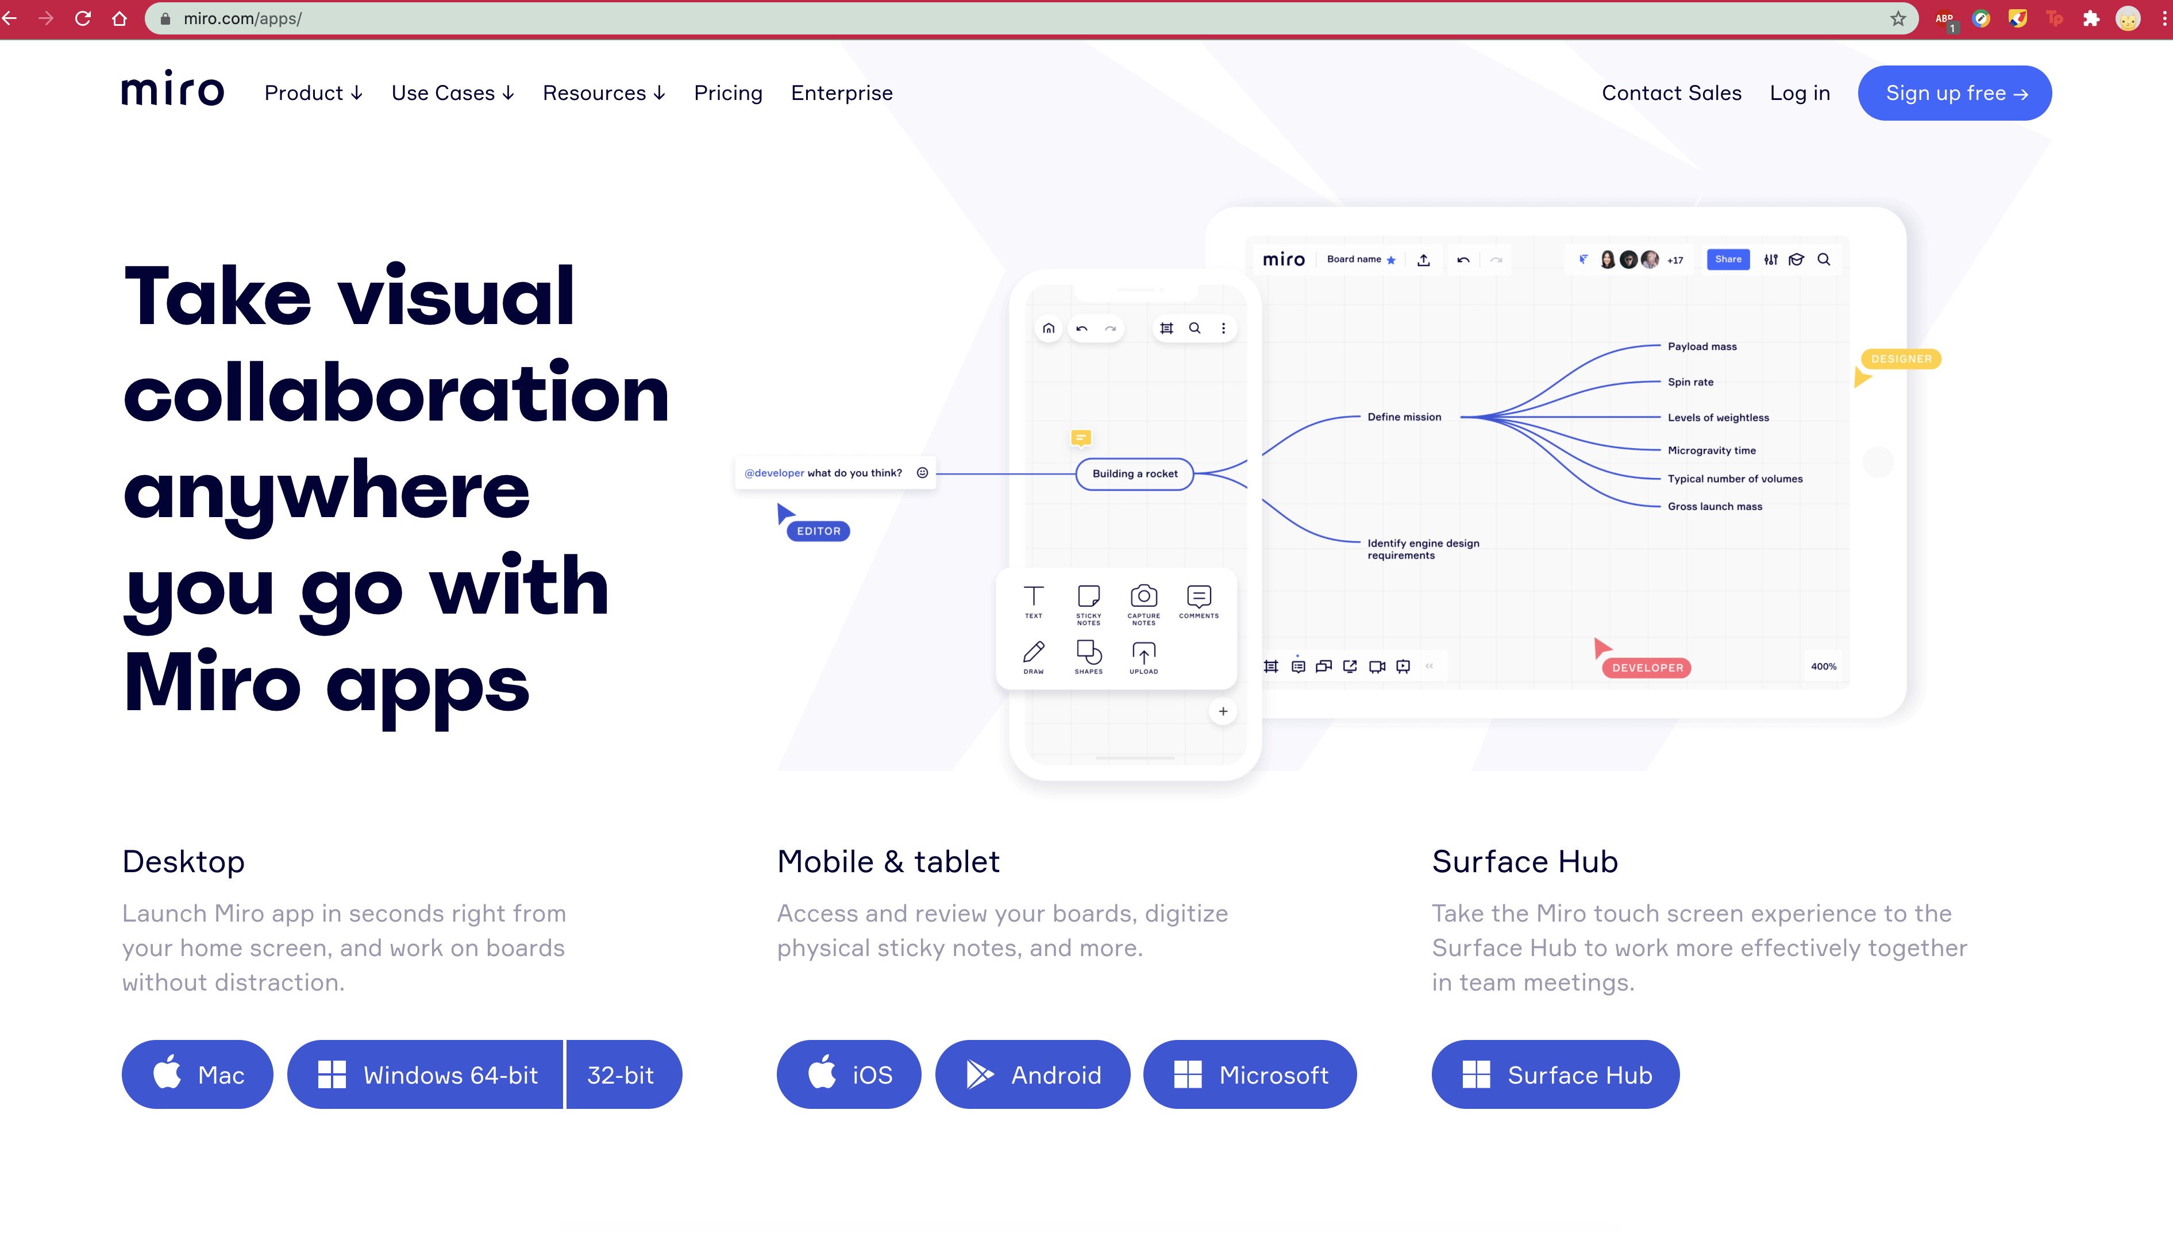
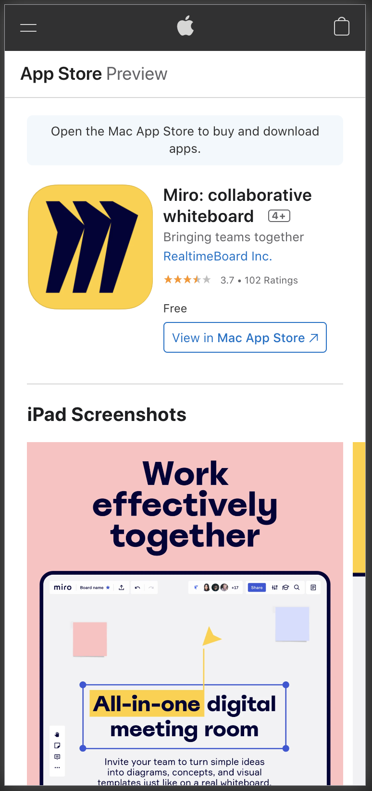
Downloadable App Example

Slide 26
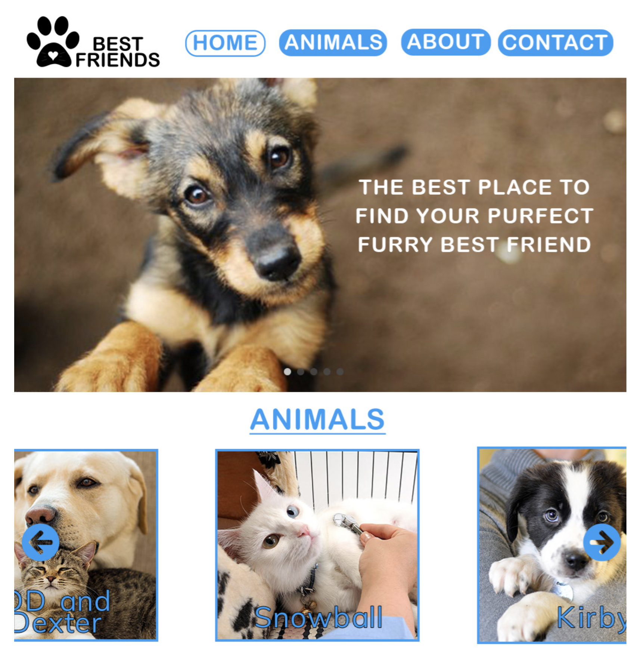
Phase 6: Pet Adoption Website

Slide 27
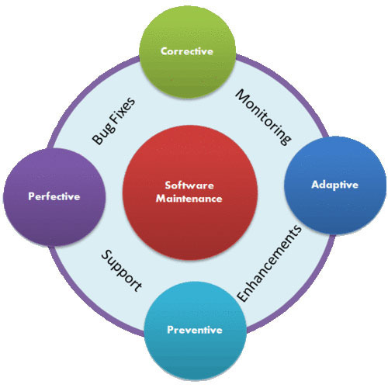
Phase 7: Maintenance
On going process
Bug fixing
Upgrades
Enhancements
Project Manager
Business Analyst
Designer
Developer
Tester
IT Operations/ System admin
Notes:
Once the system is deployed, and customers start using the developed system, following 3 activities occur
Bug fixing - bugs are reported because of some scenarios which are not tested at all
Upgrade - Upgrading the application to the newer versions of the Software
Enhancement - Adding some new features into the existing software
The main focus of this SDLC phase is to ensure that needs continue to be met and that the system continues to perform as per the specification mentioned in the first phase.

Slide 28
Popular SDLC Models
There are many
Notes:
Not always the same stages and order

Slide 29
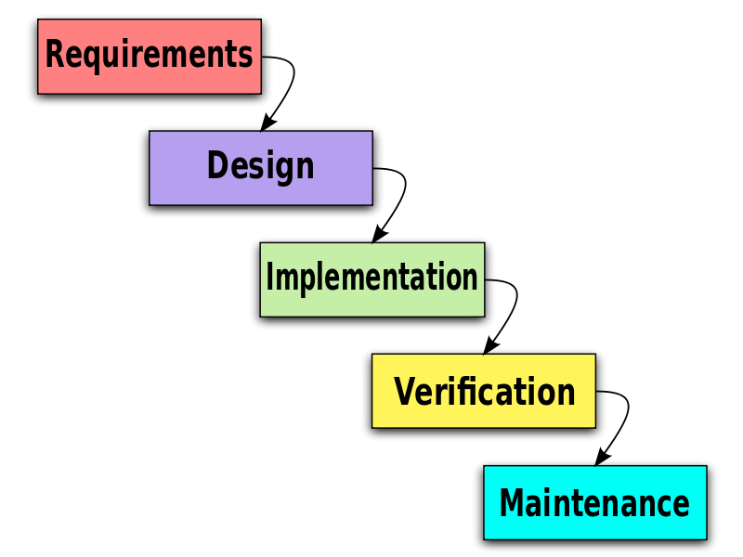
Waterfall Model
Outcome of one phase is input for the next
Documentation intensive
Notes:
The most simple, traditional and well-known methodology is the waterfall model
It’s a cascade style model in which you need to complete each phase before proceeding to the next one.
In this SDLC model, the outcome of one phase acts as the input for the next phase.
This model is documentation-intensive,
the previous phase will dictate what happens in the next phase
Pros
It has easy to understand milestones.
Management is simplified due to the model’s rigidity, meaning that processes and results are well documented for each phase.
Great for the smaller projects where requirements are clear.
Cons
High risk and uncertainty as requirements may be incomplete or change over time. The latter makes it a poor model for long and ongoing projects.
Unfortunately, the software isn’t ready until the final phase.

Slide 30
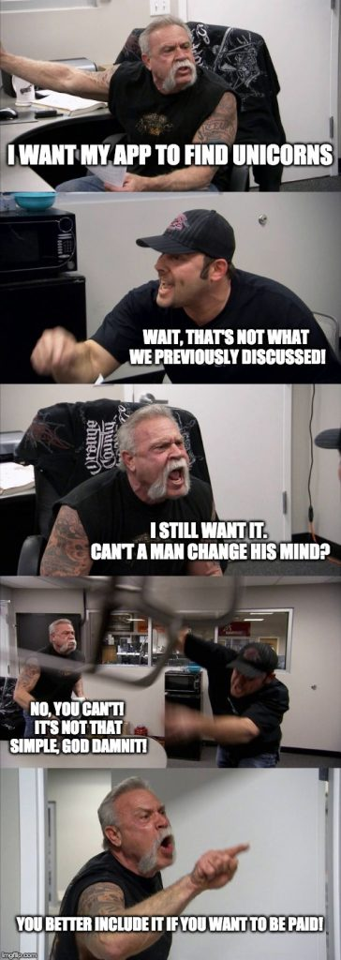

Slide 31
Incremental Model
Don’t need a full set of requirements
Slowly expand these requirements
Each cycle goes through rigorous testing and validation
Parallel development
Easily adjustable requirements
Notes:
Here, you don’t need a full set of requirements as compared to the waterfall model, but only a limited set of your product.
So, the iterative nature of this model means that you will slowly expand these requirements on each cycle until you have a finished product.
In addition, rigorous testing and validation of each software cycle represents an essential activity of this model.

Slide 32
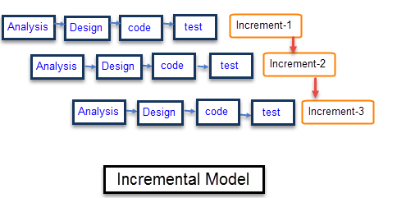
Incremental Model
Notes:
Pros
The iterative model allows for parallel development as well as for an easy adjustment to changing requirements.
The shorter the iteration, the easier the testing and debugging stages are. This allows you to discover and deal with potential defects early on.
Client feedback is based on working products rather than technical specifications.
Cons
It can be difficult to decide on an end date for your project as you could keep on iterating through your requirements.
This model is more difficult to manage and more resource intensive. Consequently, this makes it unsuitable for smaller projects.
Software engineers may encounter issues with the architecture or design as not all requirements are anticipated ahead of time.

Slide 33
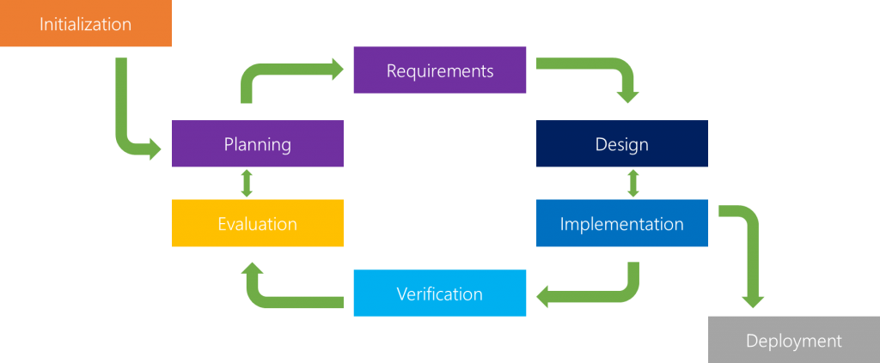
Incremental Model

Slide 34
Agile Model
Iterative approach
Several iterations until project completion
Small incremental builds
Sprint - Iteration that lasts from one to three weeks
Notes:
Agile also takes a more iterative approach.
Rather than following a linear process, you create your product through several iterations until the client is satisfied with the end result.
Each iteration, known as a “sprint”, aims to deliver a set of features requested by the client, which he or she can directly give feedback on afterwards.
and each iteration lasts from one to three weeks.

Slide 35
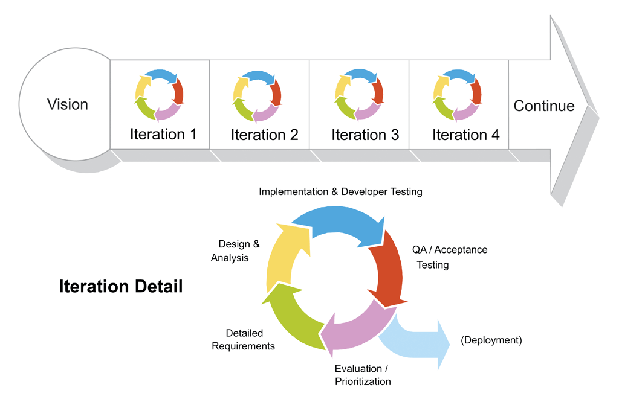
Agile Model
Notes:
Pros
Due to its iterative nature, risk is minimised as the model can adapt to changing requirements.
There is a quick release of the first product version.
It requires little to no planning.
Agile represents a more realistic approach to software development.
Cons
It can be hard to estimate the final cost and project length due to ongoing changes and an unclear outcome.
There is a lack of proper documentation due to emphasis on a working model, which can make the transfer of technology to new team members quite challenging.
Not suitable for handling complex dependencies.

Slide 36
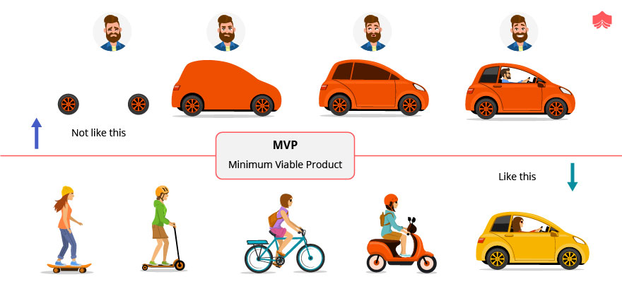
Waterfall vs Agile

Slide 37
V-Model
Validation and verification model
An extension of the waterfall model
Testing and development in parallel
Notes:
Also known as the “validation and verification” model, the V-model is an extension of the waterfall model.
In this model Verification & Validation goes hand in hand i.e. development and testing goes parallel
V model and waterfall model are the same except that the test planning and testing start at an early stage in V-Model.

Slide 38
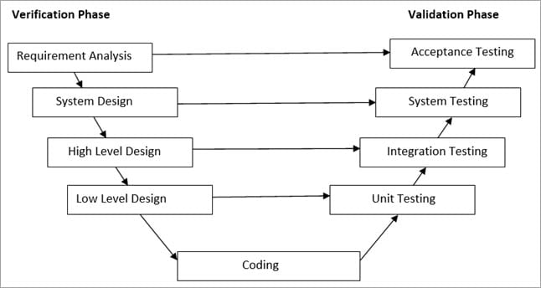
V-Model
Notes:
Pros
Similar to the waterfall model, it’s easy to manage due to its rigidity. Each phase has specific deliverables and a review process.
Compared to the waterfall model, it tends to be faster and less costly due to its early testing, thus eliminating defects in the product early on.
Similarly, it is best used in smaller projects where requirements are static and clear.
Cons
Unfortunately, V-model suffers from many of the same issues as waterfall :
High risk and uncertainty from changing requirements,
Lack of flexibility,
Unsuitability for large complex projects, and
No ready to use product until the final phase.

Slide 39
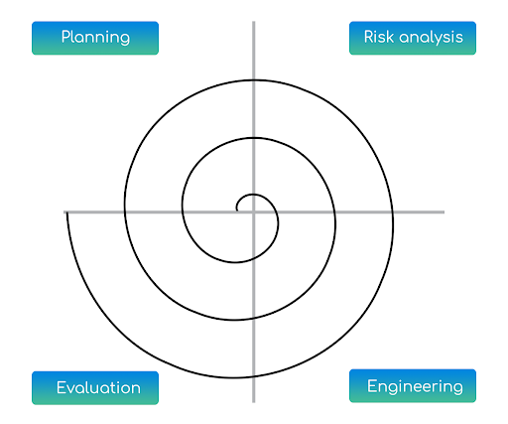
Spiral Model
Combines iterative and waterfall approach
Phases are followed in the iterations
Risk-driven process model
Prototype after each iteration
Notes:
The spiral model combines the idea of iterative development with the systematic, controlled aspects of the waterfall model
Spiral model phases are followed in the iterations.
The loops in the model represent the phase of the SDLC process
i.e. the innermost loop is of requirement gathering & analysis which follows the Planning, Risk analysis, development, and evaluation.
Next loop is Designing followed by Implementation & then testing.
The loops allows for incremental releases and refinements of the software product through iterations around the spiral.
The spiral model has a strong focus on risk assessment and minimising said risk.
Pros
Due to its iterative nature, the earlier a working prototype is created, the sooner clients can provide feedback. Consequently, the model is also accommodative to changing requirements.
Development can be divided into smaller parts, with the most risky ones being developed early on in order to manage and mitigate risk.
Processes are well documented.
Cons
The spiral model is unsuitable and expensive for small or low risk projects.
The cost can be high as it might take a large number of iterations which can lead to high time to reach the final product.
Excessive documentation is required in many phases.

Slide 40
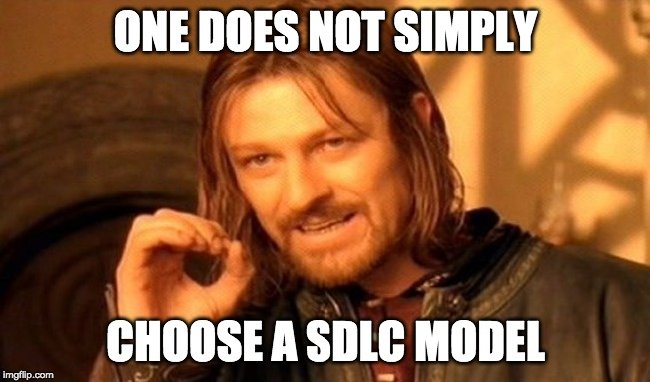
Notes:
It’s important to remember that there is no one size fits all.
Instead, you should clearly way off the benefits and drawbacks of each model compared to your own needs.
You probably also noticed that several models share similar strengths and weaknesses.
That is because they make use of similar methodologies, such as the iterative or linear approach.

Slide 41
Links/References:
https://www.guru99.com/software-development-life-cycle-tutorial.html
https://chunkbytes.com/2019/05/software-development-processes-overview/
https://www.softwaretestinghelp.com/software-development-life-cycle-sdlc/

Slide 42
Thanks!
ANY QUESTIONS?

